Slide 1

Community Grants FY23-24 Funding Opportunity
24 February 2023

Slide 2
Agenda
• Program Overview
• Evaluation Criteria
• Application Requirements and Forms
• Questions

Slide 3
Program Description
Under Nevada law, the Board of County Commissioners may award grant funding to non-profit community organizations that provide a substantial benefit to the residents of our County. Over the past 14 years The Community Grant Program has awarded over $1,870,000 to help support countless non-profit community organizations that have provided a substantial benefit to Douglas County residents.
Please NOTE: All grant awards are conditional on the Board of County Commissioners appropriating sufficient funding for the Community Grant Program during the grant cycle, and approving the grant award resolution.

Slide 4
Over the past 14 years The Community Grant Program has awarded over $1,715,000 to help support countless non-profit community organizations that have provided a substantial benefit to Douglas County residents.
County Commissioners approved a FY22-23 budget of $125,000 from General Fund and $30,000 from Social Services Fund to fund Community Grant discretionary projects.
Please NOTE: All grant awards are conditional on the Board of County Commissioners appropriating sufficient funding for the Community Grant Program during the grant cycle, and approving the grant award resolution.
FY2023-24 Community Grant
Quick Facts

Slide 5
FY2022-23 Schedule of Awarding Community Grants
February 17, 2023 – Notice of Funding Availability
    Application Package can be found at: https://www.douglascountynv.gov/cms/one.aspx?portalId=12493103&pageId=13610238
March 31, 2023 - Application due by 11:59 p.m.
April 2023 – Community Grant committee to review applications
Late April 2023 – Grant Committee to submit recommendations to the Audit Committee.
May/June 2023 – Budget approved by Board of County Commissioners. Grant Committee to present final recommendations to the Board of County Commissioners for approval.
June/July 2023 – Community Grant Funds will be awarded.

Slide 6
Award Information
Funding Availability
• $155,000 is available for fiscal year 2023-24.
• Projects will be selected on a competitive basis, consistent with the criteria outlined in the notice.
• Funds are available for expenditures until June 30, 2024.
• Pre-award authority starts on the date of project award announcement.

Slide 7
Eligibility Information
Eligible Applicants
NRS 244.1505 states that a Board of County Commissioners may grant or donate monies to a non-profit organization created for religious, charitable, or educational purposes, or to a government entity, for any purpose which will provide a substantial benefit to the inhabitants of the County.
Organizations and Agencies serving Douglas County residents.
Ineligible Applicants
Non-profits submitting an application on behave of a for-profit agency.

Slide 8
Eligibility Information
Eligible Projects
• New projects to provide a service in Douglas County
• Prior awarded projects with expanded scope
Ineligible Projects
• Regular operational costs (personnel, office supplies, etc.)
• Projects outside Douglas County
• Projects which are the same as prior years
• Projects affiliated with what the County already supplies funds to
• Previous project expenses

Slide 9
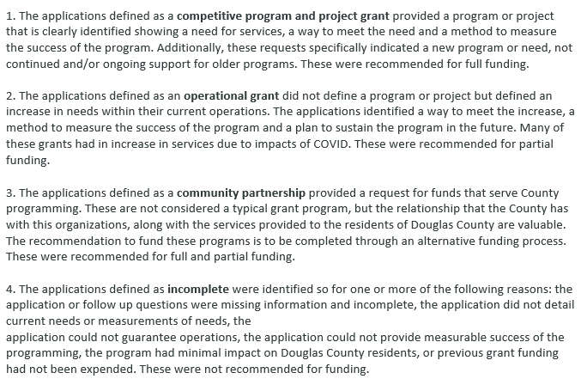
Application Review
Applications
received usually
fall into 1 of 4 defined categories.

Slide 10
Application Review
Evaluation Criteria (Con’t.)
Additional questions the reviewers have had from past applications:
1. Duplicate application from prior years. Don’t just copy and paste.
2. Incomplete or information is not clear. Reviewer left having many questions.
3. Do your financials show a negative balance? Your application may be considered a risk.
4. Are you part of a larger organization and your department isn’t listed with a separate budget?
5. If you have volunteers, make sure you show that on your organizational chart.
6. Do you say you don’t have paid employees but show outsourcing on your financials?
7. Did you submit your final grant report from the last funding period? Was it complete and on time?
8. If you are not suppling a match don’t use the terminology.
9. Supply ALL the required documentation with your application.
10. Grant applications should have a sustainable plan for how they will move forward to ensure the viability and success of these programs without community grant funding.

Slide 11
Application and Submission Information
Notice of Funding Opportunity and Application Information:
https://www.douglascountynv.gov/cms/one.aspx?portalId=12493103&pageId=13610238
Applications must include:
Application for Funding Assistance
Assurances
Organizational Chart
Recent Federal Income Tax Return or 990
Recent Balance Sheet
Organizational Budget
Completed and signed Assurance Form
Supporting Documentation
Letters of Support (optional)
If you are part of a larger organization please make sure budgets for Douglas County are visible.
Applications must be submitted by 11:59 PM PST on 31 March 2023. Late applications will not be accepted.

Slide 12
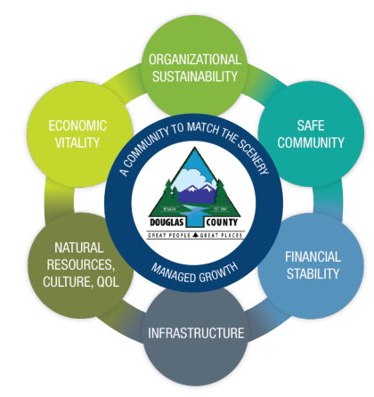
Application Review
Evaluation Criteria (The Four Hows)
Demonstration of Need - How will the proposed project address an unmet need for Douglas County?
Demonstration of Benefits - How will the proposed project support Douglas County’s Strategic Plan. https://www.douglascountynv.gov/cms/one.aspx?portalId=12493103&pageId=12553252
Local Financial Commitment – How will needed
additional funds be secured to continue the project for
future years.
Project Implementation – How will the proposed
projected be implemented.
Technical & Financial Capacity – Does the applicant have
the know-how to carry out the proposed project?

Slide 13
Resources
For Technical Assistance:
Email: Inbox - Community Grant Community_Grant@douglasnv.us
Douglas County Community Grants website:
https://www.douglascountynv.gov/cms/one.aspx?portalId=12493103&pageId=13610238
Contact: Debbie Swickard
Douglas County Grants Administrator
775-782-9029

Slide 14
Application Requirements and Forms
Applications and Forms can be found on the Douglas County Community Grants website:
https://www.douglascountynv.gov/cms/one.aspx?portalId=12493103&pageId=13610238
Douglas County Strategic Plan: https://www.douglascountynv.gov/cms/one.aspx?portalId=12493103&pageId=12553252
Douglas County Grant Program Policy:
https://www.douglascountynv.gov/common/pages/DisplayFile.aspx?itemId=15800756

Slide 15
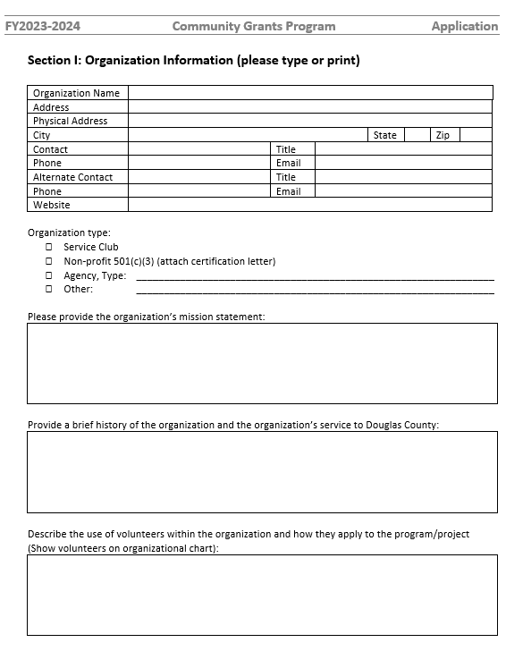
FY2023-24 Application
Tell your story so the reviewer
can understand what you are saying. Be clear & concise.
Only list volunteers you currently have helping your organization. If you are hoping to enlist more state that. Volunteers should also be on your organizational chart.
Be clear on who is paid by your organization. If you outsource then you are paying someone to work for you.

Slide 16
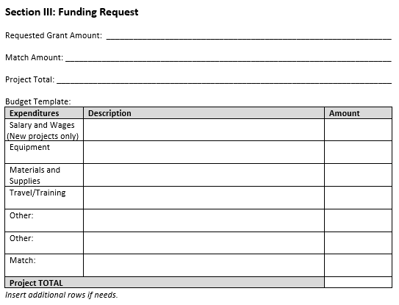
Budget
The organizational budget and Financial reports you submit show the picture of your organization. The application budget is only for your grant request.
If you have a match add the information. The total grant ask and match will equal the total project. Make sure both “Total Project” areas match.

Slide 17
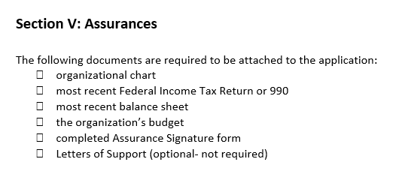
Assurances and required documents
Make sure your application is complete and all required documents are submitted.

Slide 18
Key Takeaways
Read the Instructions
Documentation is important
Tell your story

Slide 19
Questions?

Slide 20
If you have questions or need any assistance please contact:
Community Grant - Debbie Swickard –
Douglas County Grants Administrator
775-782-9029
Inbox - Community Grant Community_Grant@douglasnv.us

Slide 21
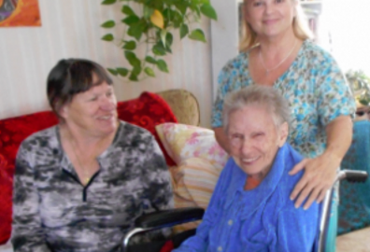
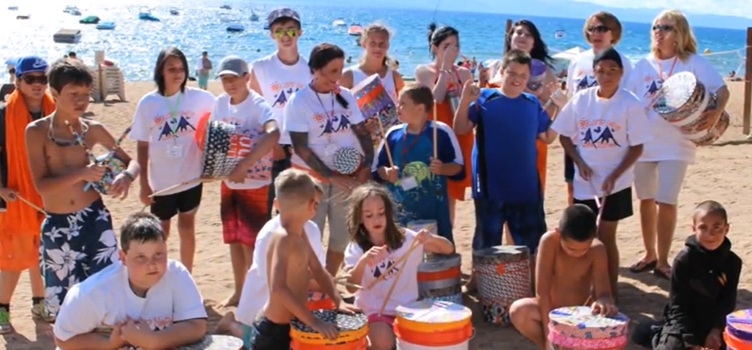
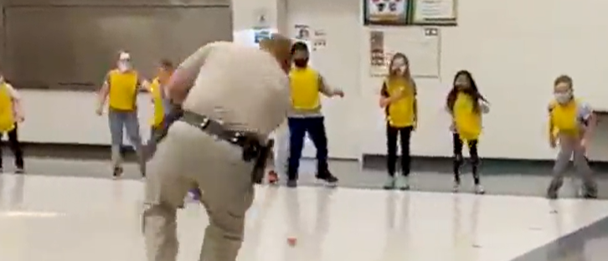
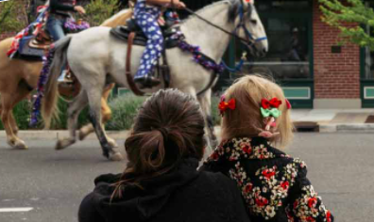


Good Luck with your projects!

